Slide 1

Chop Chop: Byzantine Atomic Broadcast to the Network Limit
Authors
Martina Camaioni, Rachid Guerraoui, Matteo Monti, Pierre-Lois Roman, Manuel Vidigueira, Gaitheir Voron
Presenters
Aunsh Bandivadekar and Srishti Singh

Slide 2

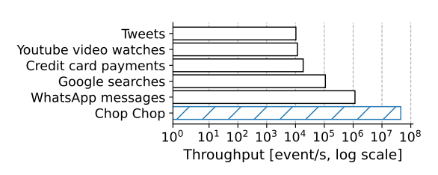
Introduction
Some Problems:
Performance
Scalability
Consistency
Attack Resistance
Complexity
Operational Management

Slide 3
Introduction
Atomic Broadcast
A fundamental communication primitive that orders, authenticates, and deduplicates messages.
Properties:
Agreement: Correct servers deliver the same messages in the same order
Validity: Messages from correct clients are eventually delivered.
Integrity: Spurious messages cannot be attributed to correct clients.
No Duplication: No message is delivered more than once.

Slide 4
Cost of Atomic Broadcast
Integrity : Digital Signatures
No duplication: Sequence Number
Overload on the application layer
Batching
For each message: 1 public key (32 B [Ed25519]) + Signature (64B) + Sequence Number (8B) + Message (4B) ~ 91% overhead
Narwhal-Bullshark-sig
Narwhal-Bullshark
Not handle authentication natively
Trusted workers become bottlenecks
No sequence number guarantees
Workers verify signatures but still workers are linked to server groups

Slide 5
Chop Chop
A Byzantine Atomic Broadcast system that amortizes the cost of ordering, authenticating and deduplicating messages, achieving “line rate”.
As a mempool, Chop Chop uses an underlying instance of Atomic Broadcast to order batches, aggregating messages to amortize costs.
Chop Chop addresses the shortcoming of authentication and deduplications with a new form of batches: distilled batches.
Chop Chop integrates the two following techniques to reduce the bandwidth and CPU cost of authentication.
Short identifiers
Pooled signature verification
Notes:
1) This paper presents Chop Chop, a Byzantine Atomic Broadcast system that amortizes the cost of ordering, authenticating and deduplicating messages, achieving “line rate” (i.e., closely matching the complexity of a protocol that does not ensure any ordering, authentication or Byzantine resilience) even when processing messages as small as 8 bytes.
2) Classic methods of batching, however, fail to also amortize authentication and deduplication: each payload in a batch still has to carry an individual public key, signature and sequence number.
3) Unlike a classic batch, a distilled batch contains condensed information that allows to authenticate and deduplicate its messages in bulk, much faster than in existing schemes.

Slide 6
Mitigations
Reduce BW and CPU cost of authentication
Short Identifiers
Repeated Public Keys consume a lot of server comm. budget
Client Joins System
Sign Up
C Announces its public key via AB
Server appends public key in directory after delivery
PK appears in same position in the directory across all servers
Client just uses its position as identifier
Pooled signature verification*
Authenticating a batch by verifying its signatures is a computationally intensive task for a server
No
Broker asks f servers more
Broker asks f+1 servers
Server send a witness shard
Broker aggregates f+1 identical shards into a witness
Broker sends it to 2f servers
Yes
At least 1 server authenticates
Result: In a 3f+1 server system, only f+1 servers verify the signatures. 2f servers avoid operation. 66% overhead reduced.
*Not all servers need to authenticate the signatures as shown by Red Belly and Mir
Notes:
SI
So repeated public key consumes lot of communication budget. better is to have servers store public keys in an indexed directory.
Upon first joining the system, a client announces its public key via Atomic Broadcast to sign up.
Upon delivering a sign-up message, a server appends the new public key to its directory.
The same public key appears at the same position in the directory of all correct servers thanks to Atomic Broadcast’s agreement.
Having signed up, a client uses its position in the directory as identifier instead of its public key.
SV
assuming at most f faulty servers, a broker optimistically asks only f + 1 servers to authenticate a batch to be certain to reach at least one correct server.
If f + 1 servers do not reply by a timeout, the broker extends its request to f additional servers, thus reaching at least f + 1 correct servers.
witness shard, i.e., a signed statement that the batch is correctly signed.
The broker aggregates f + 1 identical shards into a witness, which it sends to the other 2 f servers.
Because every witness contains at least one correct shard, the servers can trust the witness instead of verifying the batch.

Slide 7
Architecture
Chop Chop involves three types of processes :
Broadcasting clients
Delivering servers
A layer of broadcast-facilitating brokers
Chop Chop’s protocol unfolds in two phases:
Distillation
Submission
Notes:
Servers run an Atomic Broadcast instance among themselves, to which brokers submit message

Slide 8
Clients
(untrusted)
Clients
(untrusted)
Clients
(untrusted)
Clients
(untrusted)
Distillation
Broker
(untrusted)
Broker
(untrusted)
Server
(3f+1)
Server
(3f+1)
Server
(3f+1)
Submission
Notes:
In the distillation phase, clients interact with a broker to gather their messages in a distilled batch (see §3).
In the submission phase, the broker disseminates the distilled batch to the servers and submits the batch’s hash to the server-run instance of Atomic Broadcast.
Upon delivering its hash from Atomic Broadcast, servers retrieve the batch and deliver its messages.
Chop Chop’s contributions mainly focus on the distillation phase. Chop Chop’s submission strategy closely resembles prior batch-based Atomic Broadcast implementations

Slide 9
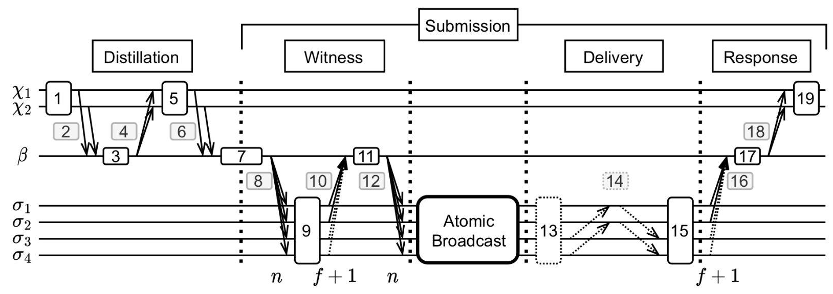
Overview: Chop Chop protocol
Distillation
Submission
Witness
Atomic Broadcast
Delivery
Response

Slide 10
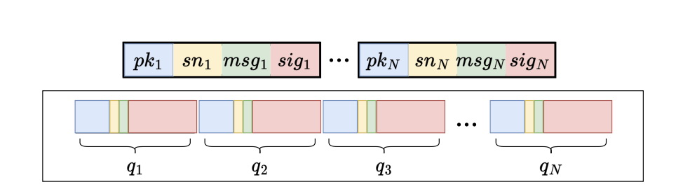
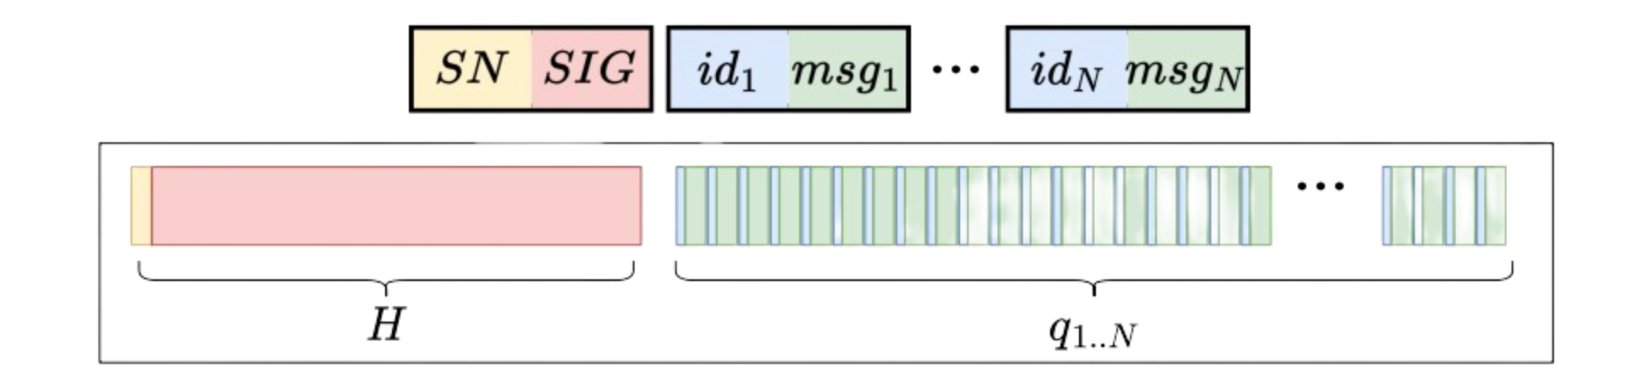
Distillation
In the distillation phase, clients interact with a broker to gather their messages in a distilled batch
With classic authentication and sequencing, each payload q_{i} contains a public key pk_{i} , a sequence number sn_{i} , a message msg_{i} and a signature s_{i}g_{i}.
In the fully distilled case, each q_{i} reduces to just id_{i} and msg_{i}: one header H, composed of one aggregate sequence number SN and one aggregate signature SIG, is sufficient for the entire batch.

Slide 11
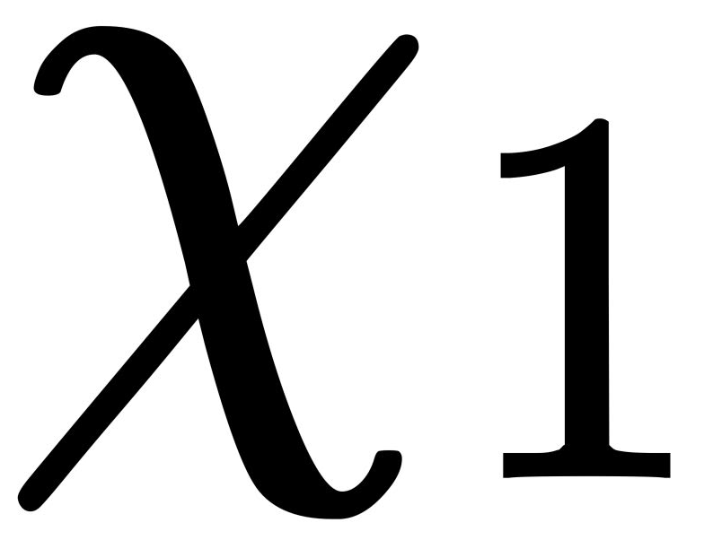
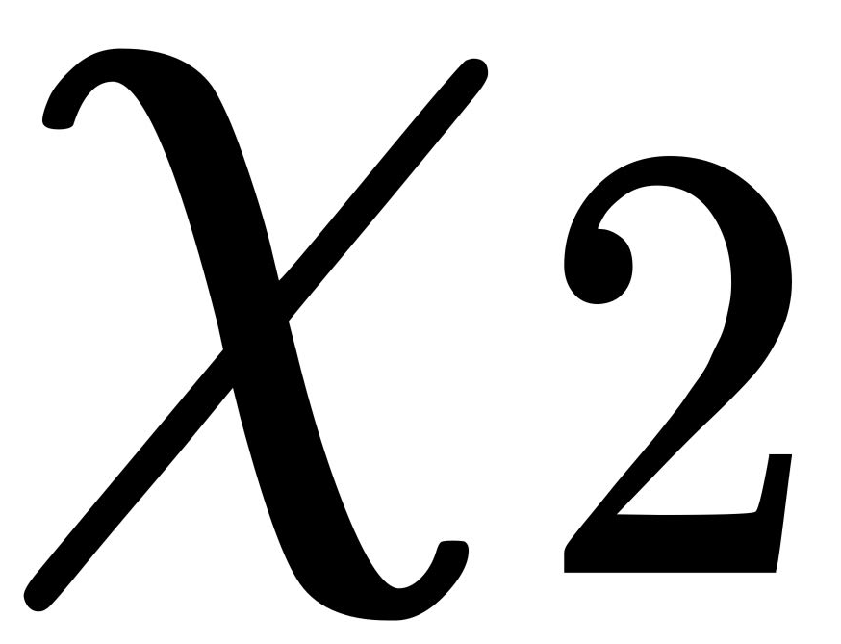

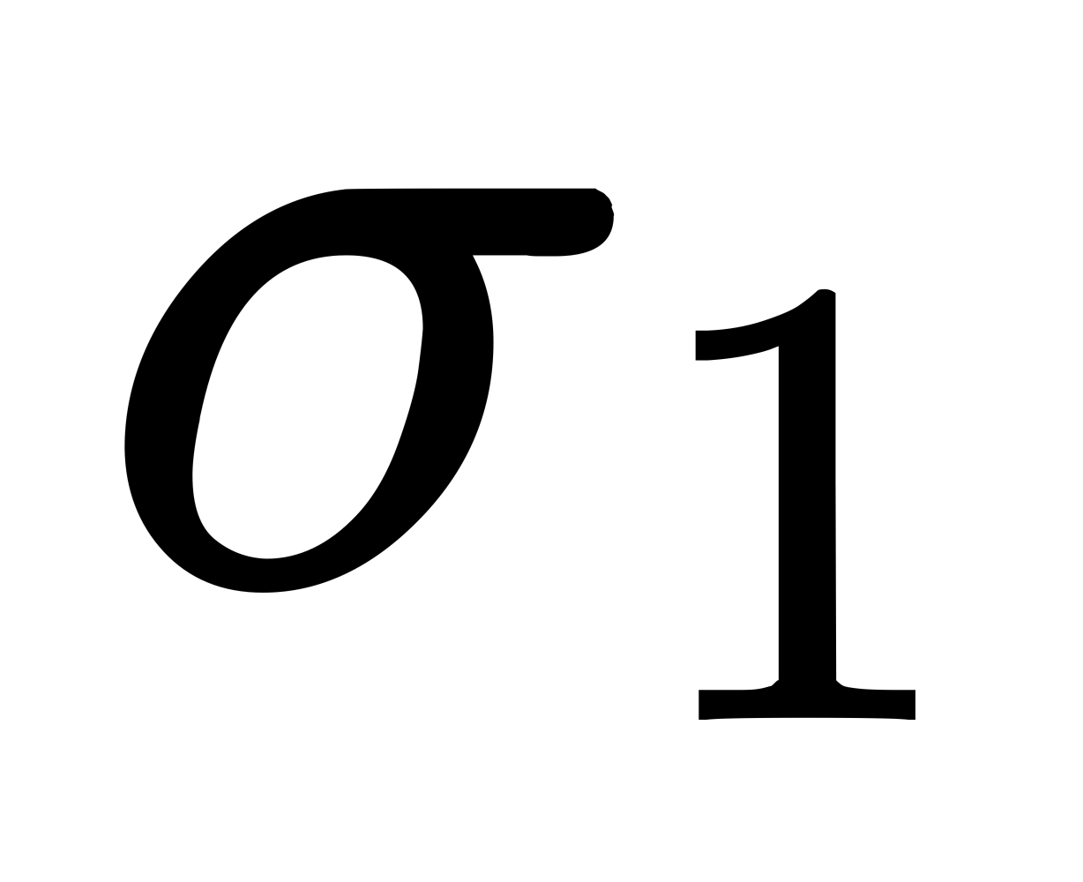
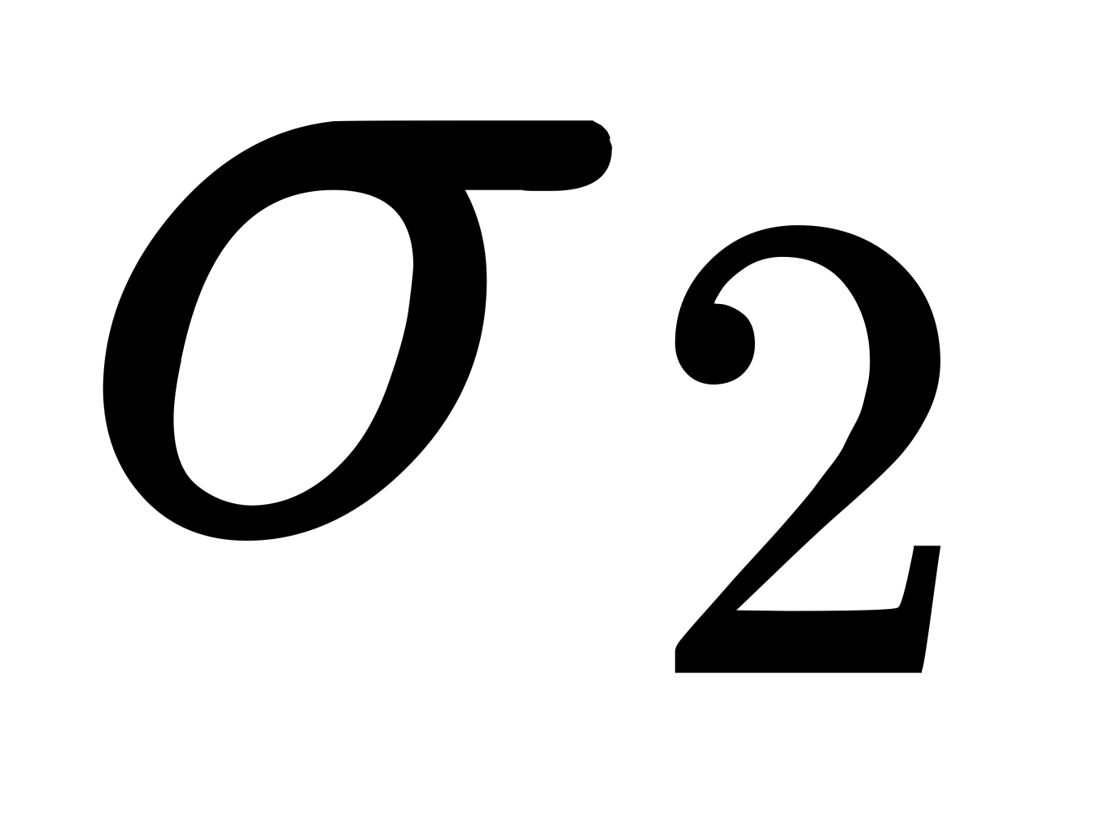
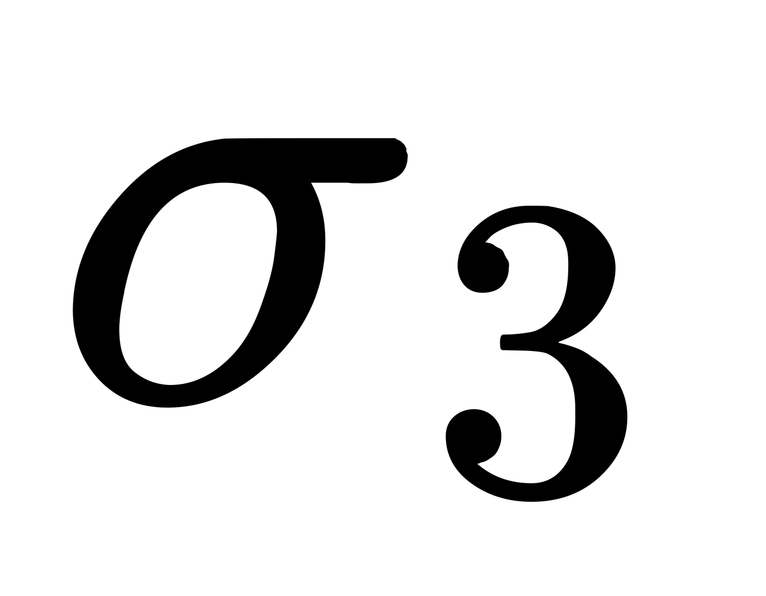
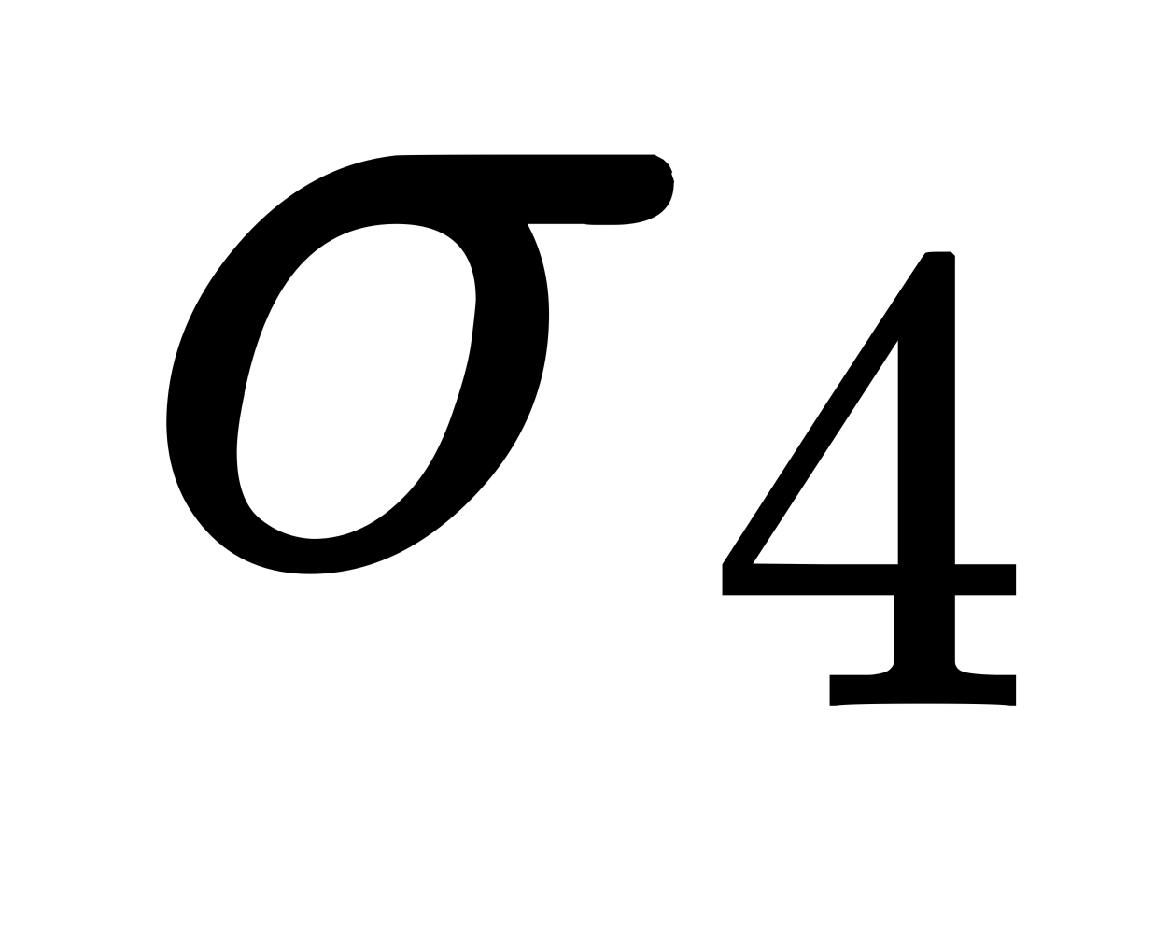
Distillation
1 and 2. Clients send messages (m₁,….m_{b}) with sequence numbers (k₁,…..k_{b}) to the broker β
Submission ->
3. Broker β identifies the max sequence number k and builds a batch proposal B = [(x₁,k,m₁),.....(x_{b},k,m_{b})]
4. Broker sends the batch proposal back to the clients
5
1
5. Each client X_{i} produces a multi-signature s_{i} on H(B) [Sign the root of tree]
2
6. Clients send the signed batch back to Broker
4
6
7. Broker produces a distilled batch B~ = [s, k, ((x₁,m₁),.....(x_{b},m_{b}))] with aggregated signature s and sequence number k
3
7
Client 1
Client 2
Broker
Servers (1…n)

Slide 12
Challenges during Distillation
What if a broker forges messages?
Can a broker avoid sending the entire batch?
What if a client does not multi-sign? (Fault-tolerant distillation)
What if a client broadcasts too frequently?
What if a client submits the largest possible sequence number?(Legitimacy Numbers | Legitimacy Proofs)
What if a broker crashes?

Slide 13
Submission: Witness & Atomic Broadcast
8. In order to collect a witness for B˜, β sends B˜ to all servers. β asks only f+1 servers to sign a witness shard
9. Upon receiving B˜, a correct server σ stores B˜.
Witness
Delivery ->
10. If asked to witness B˜, σ checks that B˜ is well-formed and sends back to β its witness shard for B˜
11. β collects and aggregates f +1 shards into a witness for B
12. β then submits B˜’s hash and witness to the server-run Atomic Broadcast
11
8
10
12
B˜ Distilled Batch
9
Atomic
Broadcast
Client 1
Client 2
Broker
Servers (1…n)
n
f+1
n
Notes:
Having gathered a distilled batch B ̃ (#7), β moves on to have f +1 servers signs a witness shard for B ̃.
In signing a witness shard for B ̃, a server σ simultaneously makes two statements.
First, B ̃ is well-formed: σ successfully verified B ̃’s signatures and found all messages in B ̃ to have a different sender.
Second, B ̃ is retrievable: σ stores B ̃ and makes it available for retrieval, should any other server need it.
β collects and aggregates f + 1 shards into a witness for B ̃ (#11), then submits B ̃’s hash and witness to the server-run Atomic Broadcast (#12).

Slide 14
Submission: Delivery & Response
13. σ deliver B˜’s hash and witness from Atomic Broadcast
14. A correct server σ retrieves B˜, either from its local storage (if it directly received B˜ from β at #8) or from another server
Delivery
Response
15. As B˜ is retrievable, σ is guaranteed to eventually find a server to pull B˜ from which it retrieves
19
16. σ signs a delivery certificate, listing the messages in B˜ that σ delivered and sends its signature back to β
17. By agreement of Atomic Broadcast, all correct servers deliver the same subset of messages in B˜. As such, β is guaranteed to eventually collect f +1 signatures on the same delivery certificate
18
17
18. Upon doing so, β distributes a copy of B˜’s delivery certificate to X₁,...,X_{b}
16
19. Armed with B˜’s delivery certificate, a correct X_{i} can publicly prove the delivery of m_{i} and safely broadcast its next message
14
13
15
Client 1
Client 2
Broker
Servers (1…n)
f+1

Slide 15
Correctness
Correctness
Safety
Liveness
Agreement
Integrity
No duplication
Validity
Notes:
The safety of Chop Chop is given by its agreement, integrity and no duplication properties.
Agreement: All correct servers deliver the same messages in the same order assuming cryptographic hashes are collision-resistant.
Integrity: a correct server delivers a message m from a correct client χ only if χ broadcast m.
No duplication: no server delivers a correct client’s message more than once.
The liveness of Chop Chop is given by its validity property. all correct clients are eventually guaranteed to find a correct broker and get their messages delivered by all correct servers.

Slide 16
Implementation
Implemented in Rust, totalling 8900 lines of code.
Main libraries
tokio for an asynchronous, event-based runtime
rayon for worker based parallel computation
serde for serialization and deserialization
blake3 for cryptographic hashes
ed25519-dalek for EdDSA signatures
blst multi-signatures on the BLS12-381 curve
In-house libraries talk - for basic distributed computing and high-level networking and cryptography
zebra Merkel-tree based data structures
Notes:
The goal of a Chop Chop broker is to produce batches as distilled as possible (to minimize server load), as large as possible (to amortize ordering), and as quickly as possible (to minimize latency).
Our target is for a broker to assemble one fully distilled batch of 65,536 messages (736 KB, see Fig. 3) per second, with a 1 second distillation timeout.
The goal of a Chop Chop server is to process distilled batches as quickly as possible without overflowing its memory.

Slide 17
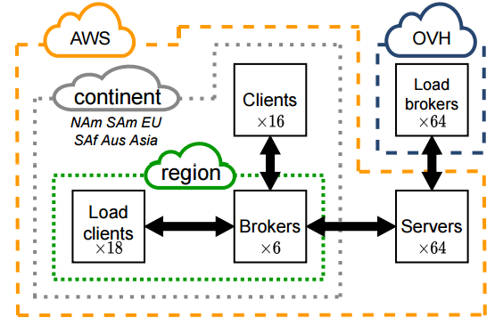
Evaluation
Servers:
64 c6i.8xlarge AWS machines
32 vCPUs, 16 physical cores per machine
Spread across 14 regions globally
Batches:
65,536 messages per batch
8 bytes per message
736 KB per batch
Resilience:
Tolerates up to 21 out of 64 faulty servers
Clients:
16 small T3 AWS machines across regions
Produce load up to 257 million clients
Load Clients & Brokers:
320 large AWS & 64 OVH machines
Simulate high load on servers and brokers
Networking:
Geo-distributed
High bandwidth connections
TCP tuned for high throughput

Slide 18
Evaluation
Let’s evaluate Chop Chop
What workload can Chop Chop sustain?
What are the benefits of Chop Chop’s distillation?
How does Chop Chop scale to different numbers of servers?
How efficiently does Chop Chop use resources overall?
How does Chop Chop perform under adverse conditions, such as server failures?
What performance can applications achieve using Chop Chop?

Slide 19
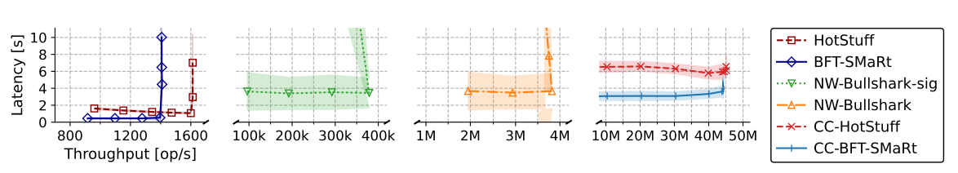
Eval: Load Handling
Fig. shows Latency v Throughput for various input rates of 8B messages
Baselines:
BFT-SMaRt and HotStuff peak at 1.6K ops/sec
Narwhal-Bullshark reaches 3.8M ops/sec
Narwhal-Bullshark-sig peaks at 382K ops/sec
Chop Chop achieves:
43.6M ops/sec with BFT-SMaRt
44M ops/sec with HotStuff
Latency between 3 and 6 seconds
Trade Offs:
Chop Chop trades higher latency for maximum throughput
Batching contributes to latency
Still comparable to Narwhal's latency

Slide 20
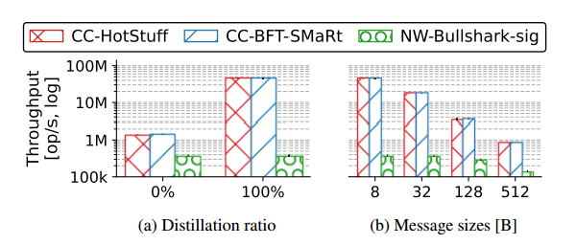
Eval: Distillation
Fig a. Throughput with 0% and 100% Distillation
Fig b. Throughput with varying message sizes
Distillation vs Mitigation
1.5M ops/sec with mitigation techniques
44M ops/sec with full distillation
29x speedup from distillation
Distillation for Larger Messages
Chop Chop sustains line-rate for varying message sizes
Throughput scales linearly with message size
Consistently faster than baseline

Slide 21
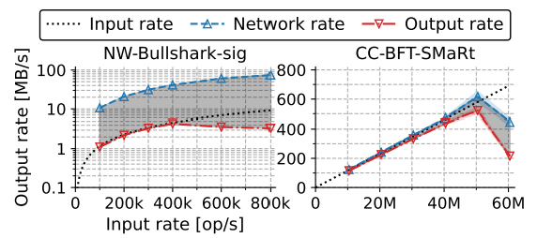
Eval: Distillation (Line Rate)
Fig. Illustrates Chop Chop’s near line-rate network use by depicting its input, network and output rates:
Input Rate:
Measures total rate of useful information (messages) entering brokers/servers from clients
Reflects throughput of atomic broadcast usage
Network Rate:
Measures all information (including protocol overhead) ingress servers receive
Input rate + overhead from cryptography, ordering, etc.
Output Rate:
The "goodput" - useful application-level throughput delivered by servers
Messages per second finally delivered to receiving applications
Line Rate
Under 8% overhead beyond raw network usage
Baseline has over 90% overhead
Distillation achieves effective line rate

Slide 22
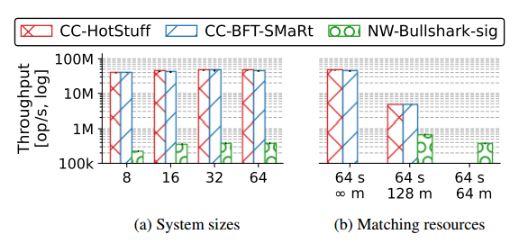
Eval: Number of Servers
Fig a. Throughput varying system sizes
System sizes evaluated: 8, 16, 32 and 64 servers
Both Chop Chop and Narwhal-Bullshark-sig scale well upto 64 servers
Narwhal-Bullshark-sig only scales vertically. If a server or workers are faulty the entire server group is compromised
Chop Chop also scales horizontally with more brokers

Slide 23
Eval: Overall Efficiency
Fig a. Throughput with varying number of machines when
resources are kept constant
Hardware resources matched between systems
Chop Chop: 64 servers & 64 brokers
Narwhal-Bullshark-sig: 128 workers
Chop Chop achieves 4.6M ops/sec
Narwhal-Bullshark-sig reaches 679K ops/sec
Chop Chop has higher throughput with same resources
Untrusted brokers provide additional scalability. Trusted workers contribute to its own server group.

Slide 24
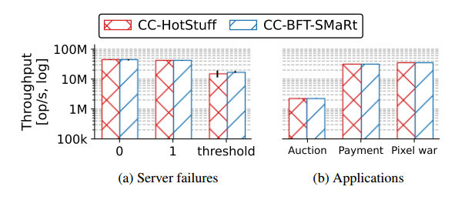
Eval: Chop Chop Under Failures
Fig a. Throughput with various server failures (when failing 30s into
the run)
Failures Evaluated:
Crash of servers
Clients not participating in distillation
Effect of Server Crashes:
43M ops/sec with no crashes
Marginal drop to 42M ops/sec with 1 crash
66% reduction to 15M ops/sec with max failures
Effect of No Distillation:
Max throughput drops from 44M ops/sec to 1.5M ops/sec
Worst case without distillation

Slide 25
Eval: Application Use Cases
Fig b. Throughput with various application use cases
Apps:
Payment: 32 M op/s
Auction: 2.3 M op/s
Pixel War: 35 M op/s
Features:
Bottleneck is the application itself
CC has sufficient capacity for high, single-application throughput
Can support many separate high-throughput apps
Applications only handle core logic, Chop Chop provides messaging fabric

Slide 26
Future Work
Chop Chop's rapid throughput makes memory management difficult: servers quickly fill their memory if they are unable to garbage-collect under severe load.
All Chop Chop servers are known at startup, and it is unknown whether its performance would be maintained when distributed on hundreds of servers.
Future research could focus on sharding to obtain even higher throughput by operating many, independent, coordinated instances of Chop Chop, as well as delegating more jobs to the brokers, such as public key aggregation.

Slide 27
Conclusion
Chop Chop accelerates the throughput of atomic broadcast protocols by orders of magnitude via a novel distillation technique and untrusted brokers
Distilled batches amortize expensive authentication and deduplication over large message sets by aggregating signatures and sequence numbers.
An untrusted layer of brokers performs heavy cryptographic operations like distillation outside the trust boundary. This prevents wasting scarce and expensive trusted resources.
Together these innovations enable a geo-distributed deployment to achieve 43 million operations per second with just 64 servers. This gets within 8% of theoretical line rate.
The raw throughput unlocks new potential decentralized applications in finance, communication, gaming etc. that need global scale.
Compared to its closest competitors, Chop Chop improves throughput by up to 100x.

Slide 28

THANK YOU

